Slide 1
TypeScript
Typing, Variables, and Functions
Lecture 2
By James(Jin) Wang
09/15/2019

Slide 2
Outline
Grammar, Declarations and Annotations
Type and Ambient Declarations
Any and Primitive Types
Object Types
Functions

Slide 3
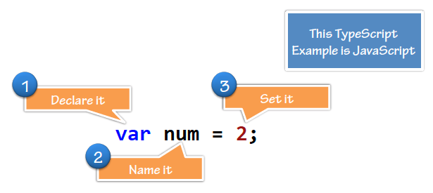
Grammar, Declarations and Annotations
  Grammar: Type Inference:

Slide 4
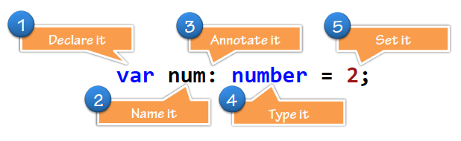
Grammar, Declarations and Annotations
  Grammar: Type Annotations:

Slide 5
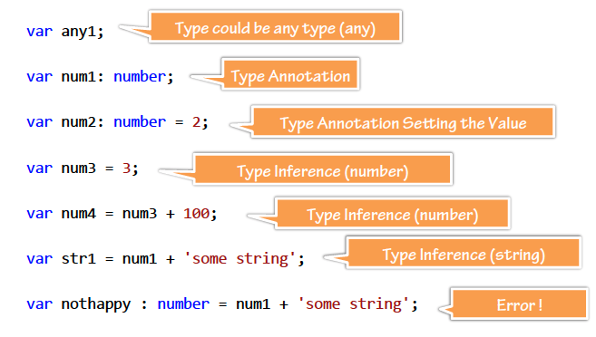
Grammar, Declarations and Annotations
  Annotations and Inferences:
  Demo: Grammar
  Demo: Timer

Slide 6
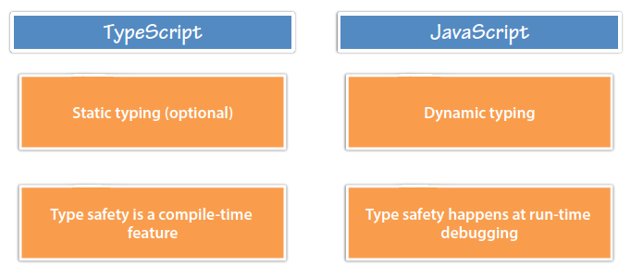
Typing and Ambient Declarations
  Dynamic and Static:

Slide 7
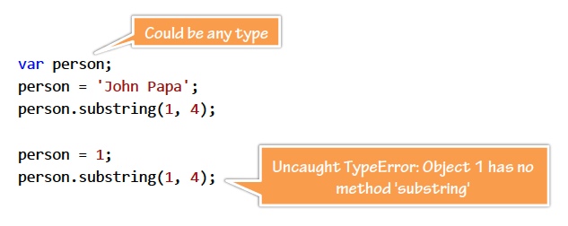
Typing and Ambient Declarations
  JavaScript’s Dynamic Types:

Slide 8
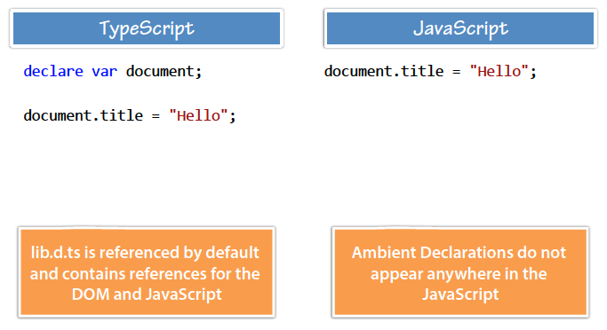
Typing and Ambient Declarations
  Ambient Declarations:

Slide 9
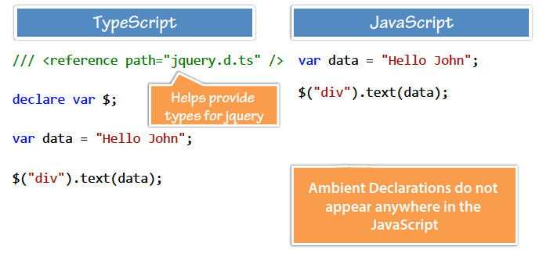
Typing and Ambient Declarations
  Type Definition Files:
  Demo: Dynamic Types

Slide 10
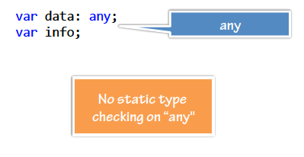
Any and Primitive Types
  Any:

Slide 11
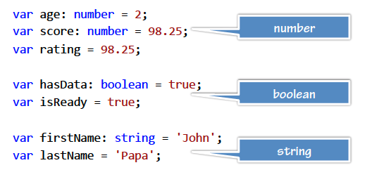
Any and Primitive Types
  Primitive Types:

Slide 12
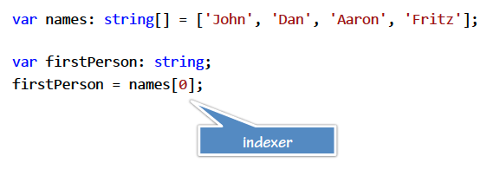
Any and Primitive Types
  Arrays and Indexers:

Slide 13
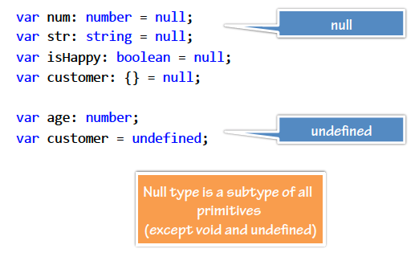
Any and Primitive Types
  Primitive Types - Null:

Slide 14
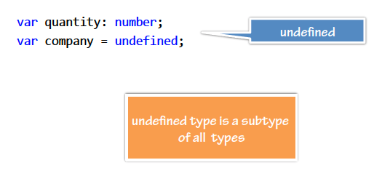
Any and Primitive Types
  Primitive Types - Undefined:

Slide 15
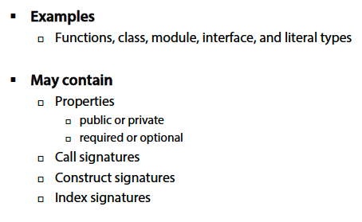
Object Types
  Object Types:

Slide 16
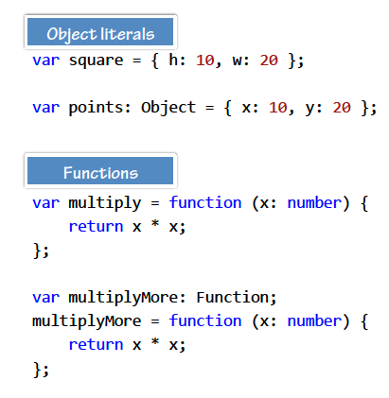
Object Types
  Object Types:

Slide 17
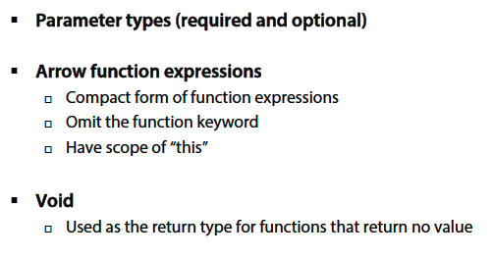
Functions
  Functions:

Slide 18
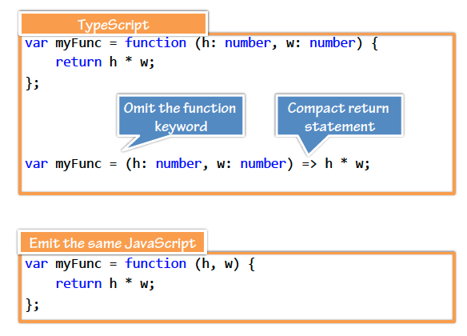
Functions
  Arrow Function Expressions:

Slide 19
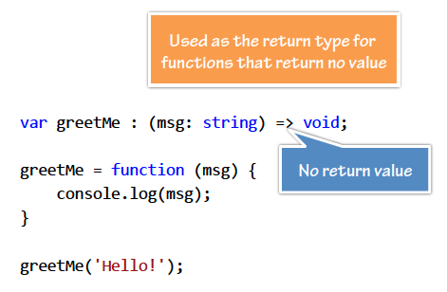
Functions
  Void:

Slide 20
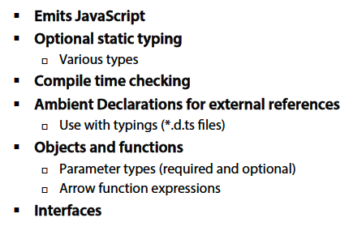
Summary

